Slide 1


Incubating New & Beginning Farmers

Slide 2

Loss of Agricultural Intellectual Capital
Aging population of farmers
Ag as a Business is not taken seriously
Low profits high risk
No transition for new and Beginning farmers program
Lack of Synergy between ag stakeholders
Notes:
Farmers are aging as we all know, researchers estimate that farmers over age of 55 control more than half of all farmland, half of them will retire over the next decade. As the age of US farmers has continued to increase,the number of farms and number of new/beginning farmers has declined.
In addition, US agriculture is entering into a period of enormous land transition. The USDA estimates that about 70% of farmland will change hands over the next two decades. As fewer Americans grow up on farms, the pathway to farming as an occupation has shifted dramatically. Beginning farmers are much less likely to inherit or purchase land from family members. So it causes raise the barriers to entry for beginning

Slide 3
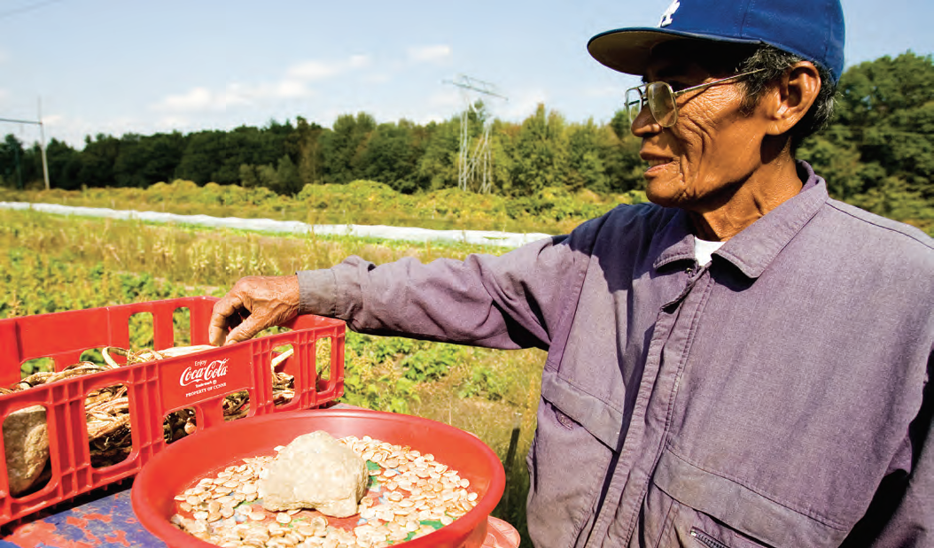
Mission &
Vision & Concept
Mission: The Terp Farm Incubator contributes to the growth and success of emerging and transitional full-time farmers by leveraging existing support programs and providing best in class business incubation services through farm-based and virtual programs
Vision: The Terp Farm Incubator supports a stronger, more sustainable, agricultural presence in Maryland that contributes to a healthy local food systems through economically viability as well as environmental and social sustainability farming.
Notes:
farmers even higher.
Under this circumstance, farm incubator represents a unique and relatively new approach to addressing the many challenges and obstacles faced by beginning farmers. The significance of the farm incubator model is twofold: not only can farm incubators support the development of new farm enterprises, they can also encourage the growth of strong local food systems.

Slide 4
Property Based Training
Virtual Training
Partnerships
UMD Affiliation
Intellectual Capital
Terp Farm Incubator
An Extended Program to Achieve Profitability
Rigorous Screening Process
Clear Transition Process
Notes:
Our Virtual facility helps us to target Older farmers who have capital and don’t need facilities
UMD Affiliation Both Virtual and property-based training Partnerships Intellectual Capital Rigorous screening Process Clear transition process An Extended Program to achieve Profitability
Business concept will be pitched to various GSE to host the program.
Incubator will have will provide additional goods and services to the market to sustain the program.
Incubator will be a partnership between various stakeholders.
Banks
NGOs
PG County
UMD
Beginning Farmer programs
Law firms
Ag experts
Incubator will act as a next step for other incubator programs like future harvest casa.
Incubator will accept virtual applicant from all over the US depending on their need.
All on site tenants will have to leave within a 30 miles radius

Slide 5
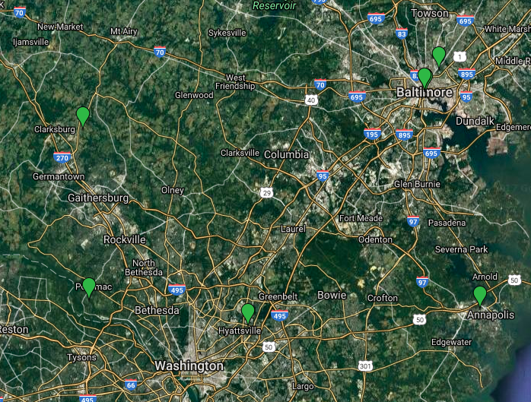

Industry Background
Notes:
Total of 7 incubator programs in Maryland
3 programs near Baltimore area are in operation
Other 4 programs not yet in operation
In USA and CANADA
59% are operational farm incubators
24% are potential farm incubators (it means that is in the planning/development stage)
12% are university programs
5% are farmer training programs that do not provide access to individual plots of land
Though a small number(6) of them have been operating for over ten years, farm incubators are still a relatively new model for beginning farmer training. Most of them are in the initial planning and development stages.
As is known, most farm incubator rely on funding or grants to survive. Typically, do you know what funding,or capital, do they use, generally??? In general, we have federal grants, foundation grants, farmer fees,local government funding and university funding. Here is another question, how about the funding importance?
A survey was done to ask incubator operators to rank sources of funding from most important to least important. Obviously, most of them indicated that federal grants is the most important source for their projects.
Demographic of participants
Over 50% of farm incubators projects are designed to meet the needs of refugee or immigrants communities.
111 known farm incubators in U.S. and Canada (Composition)
Funding Importance
Demographic of Participants

Slide 6
Organizational and Management Plan
Stage 1 - Introduction
Stage 2 - Growth
Stage 3 - Maturity
Focus on farm operation
Be economically sustainable in 3-5 years
Prepare for growth stage
Apply for the incubator
Start incubator program
Refine the business plan
Accomplish 25 percent graduation rate each year
Earn stable profit to cover total operating expenses
Achieve sustainable development in 7-8 years
Notes:
Stage 1
Focus on farm operation
Be profitable in 3-5 years
Prepare for growth stage
Apply for the incubator
Stage 2
Start incubator program
Refine the business plan
Accomplish 25 percent graduation rate each year
Stage 3
Earn stable profit to cover total operating expenses
Achieve sustainable development in 7-8 years
Program/Service
Specialty Processes (pollinators, brewing,value-added,butchering)
Livestock Processes
Horticulture Processes
Business Education (accounting, taxes,contracts.)
Equipment Education
Marketing (agrotourism, branding, social media, etc.)
Network Establishment (accountants, vets, lawyers)
Business Planning
GAP and other compliance training (for licenses)
Farm Evaluation
Business Evaluation
Peer to peer Network establishment

Slide 7
GET
GROW
KEEP
Social Media
E-newsletter
Advertising
Host special events
Ag competitions
Contractual programs
Farmer network
Registration Waiver
Alumni Association
Referral Program
Ambassador Program
Recommending Circles
Annual Evaluations
Incubator Evaluations
External Evaluations
Growth
Foster Collaboration
Improving Service Network
Annual Check-In
Notes:
How does the incubator program attract the applicants and what service we can provide
Provide basic training and invite speaker for specific needs from applicants and hold some events to the public.
Leadership from Board membership can the significantly influence promotion. Convincing applicants that our program have support from the authority party. Also being
we implement the contracts on applicants and it works like graduates from bachelor and switch to the master degree, we sign the contracts to make sure human resource stability.
We will also get members from ag competition by selecting the winners or compatible program to join the incubator.
Advertise the incubator on the UMD campus.
Build a strong alumni network for referrals into the program.
Even after graduation, participants will remain involved in the program and will be provided basic support when needed.
Social Media is going to be a major tool for our outreach because we will be dealing with the younger generation most of these participant will not use direct mail.
We will partner with local community organization and participates in their events.
Web-based comm are increasingly at the center of outreach and are certainly very important. However, it also have the effect of filtering the same underserved populations that some programs may most want to reach. Thus, in the intake phase alone, some programs should spend up to four times as much time corresponding with target limited resource participants.

Slide 8
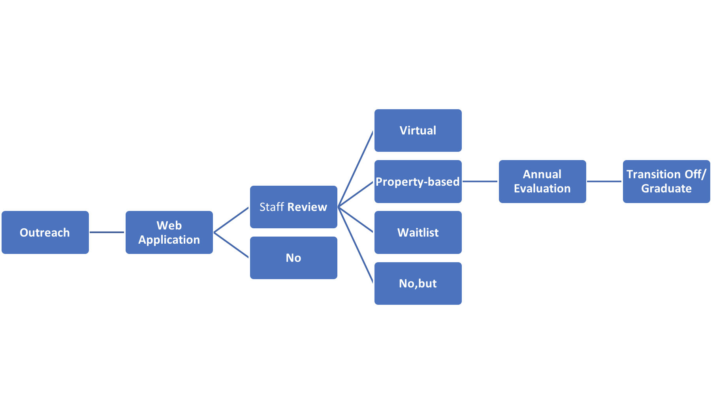

Operation Process
Notes:
We will not have competing Businesses at the same stage of their business. This will help eliminate competition amongst tenants.
Incubator projects generally have limited capacity and want to set up new farmers to be successful.Thus, finding candidates who will be a good fit for the program would be very very important.
The admission rate should be around 0.2: (How many people do we need to screen to fill the incubator?)
We need to have 50 people screened.
Eventually, the general manager will pick ten applicants for incubation.
The following is to explain the above graph with detail.
Web Application
Application fee: 50 dollars per applicant to submit the application.
All applicants need business plan or logic model
Questions or Criteria:
How much past experience?
Given the incubator mission to leverage current systems, we on creating working relationships with program like the ones listed below in order to find applicants. The exact number of programs are incubator connects with is at the discretion of the general manager, but Terp Farm and Future Harvest CASA will have a connection to the incubator.
Livestock
Completion of Penn State online beef cattle class or comparable program
Produce
TerpFarm, Future Harvest CASA lvl 2 or 3 or comparable program completion
Do you intend to make farming your primary source of income?
What
Sample：
https://sway.com/IebEAGSmFnN3QpZL?ref=Link&loc=play
Staff Review (need a general manager )
The executive director should be present at this phase to screen applicants.
At this phase, the executive director are required to make sure that the applicants who will enter the board interview must meet all the basic requirements. This phase would serve as a simple and basic interview before the board interview where board members would make the final decision.
Criteria/ Questions:
Skill Assessment:(know their skill level and tailor your programming to their needs)
Baseline skill assessments should cover:
Previous experience
Where was thier facility or do they have one?
What enterprise?/what capacity?/ how long did you farm?/ where did you sell your products?/ any received formal education in farming?
Self-assessment Tip: People tend to overestimate their own skills.Thus, tey to find more objective ways of establishing skills level in addition to asking them what they know.
Once the staff review is conducted, the applicants will be assigned to one of the following groups
“No” means that you are declined.
“No,but” means that if this applicant could complete those requirements, like taking a class, and reapply, the board members would consider you. If an applicant is missing a skill that one of our affiliated programs offer, we will tell them to attend
“Wait List” means that although you are qualified, we don’t have seats available for you. So, if the applicant are willing to wait in the waitlist, it is likely to have the applicant in if some participants failed in the future.
Accepted applicants will be put into either the virtual incubator or the property based incubator based on their needs. The general manager will handle the contracting and processing.
Annual Evaluations will be conducted to assess the applicant progression inside the incubator.
Graduation from the program is dependent to the growth rate of the incubator clients.

Slide 9

Incubator Programs— Operation Plan
Programs
Specialized Production training
Business Development
Marketing
Farm Financials
Risk Management
Notes:
The incubator will create relationships with pre existing programs to improve clients technical and professional skills. Acceptance to an incubator will mean admittance to certain classes.
Possible classes may include, Futures Marketing, Marketing, Farm financials.
Business development: Advanced topics in business such as expanding the business ( knowing when to invest in capital vs. more labor) and ensuring that their current progress is in line with their plan.
Marketing:
Marketing would include the following topic areas:
Market research/ competitive advantage/ pricing/ promotion/ record-keeping/ customer service/ grading and product quality
Farm Financials:
It would probably cover
Sales projections
Expense forecasts
Break even analysis
Taxes (when and how to file) (Most likely in conjunction with an accountant)
Help these farmers keep good financial records and understand the ins and outs of their biz finances would set them up to access opportunities and success.

Slide 10

Products and Services
Goals
-Recoup invested money
-Ensure success past 5-8 years of new small business ventures
-Self-sufficiency after program completion
-Maintain low costs/overhead for beginning farms.
Notes:
-Recoup invested money
-Ensure success past 5-8 years of new small business ventures
-Self-sufficiency after program completion
-Maintain low costs/overhead for beginning farms.

Slide 11
Products and Services
Facility
Virtual
Professional training (Beef Backgrounding, Horticulture Production, Pollination services)
Mentor-Protege Relationship
Market establishment
Intellectual ‘Know How’ network
Business Evaluation
Spot Assistance
Notes:
The facility incubator will house 10 clients businesses. The make-up of these client pools will be dependent on the clients that apply but the 10 acres of land for horticultural production will need to be filled as much as possible.
The virtual ‘incubator without walls’ will be operating on an as-needed dynamic basis. The main goal fo the virtual incubator will be connecting clients with services outside of our incubator that we cannot provide, though spot assistance will be given when expertise is available.

Slide 12
Incubator Without Walls
Spot consulting-assistance budgeting, creating food plans, designing farms, etc.
Resource distribution- splitting costs of operating expenses accounting, legal aid, taxes, etc.
Networking- connecting clients to veterinarians, lawyers, accountants, other farmers, etc.
Mentoring
Virtually broadcast seminars

Slide 13
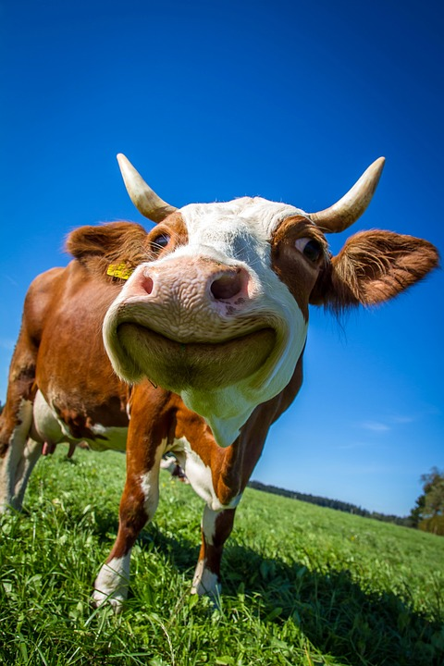
Beef Backgrounding
Optimization of marketing plan (necessary prior to embarking on venture)
Implement preventative health plan
Assure animals are preconditioned
Will take place on our feedlot
Risk management
Notes:
Optimizing the marketing plan will be necessary prior to embarking on bovine purchases, we will need to know the specifics about where the entire lifespan of the cattle will be prior to purchase
(Supplements, Vaccinations(IBR,BVD, P13, BRSV 7 Clostridial strains) , Deworming, Implant growth promotants, Proper identification (RFID or Eartag)
Preconditioned means weaning of cattle from the parent- ensuring the immune system is ready for solo living
The entirety of the property, short of 10 acres will be used for the backgrounding venture- rotational grazing and pasture management plans will need to be put in place
(Facilities and equipment insurance, Multi Peril crop insurance, NAP (noninsured assistance program thru USDA farm agency)

Slide 14
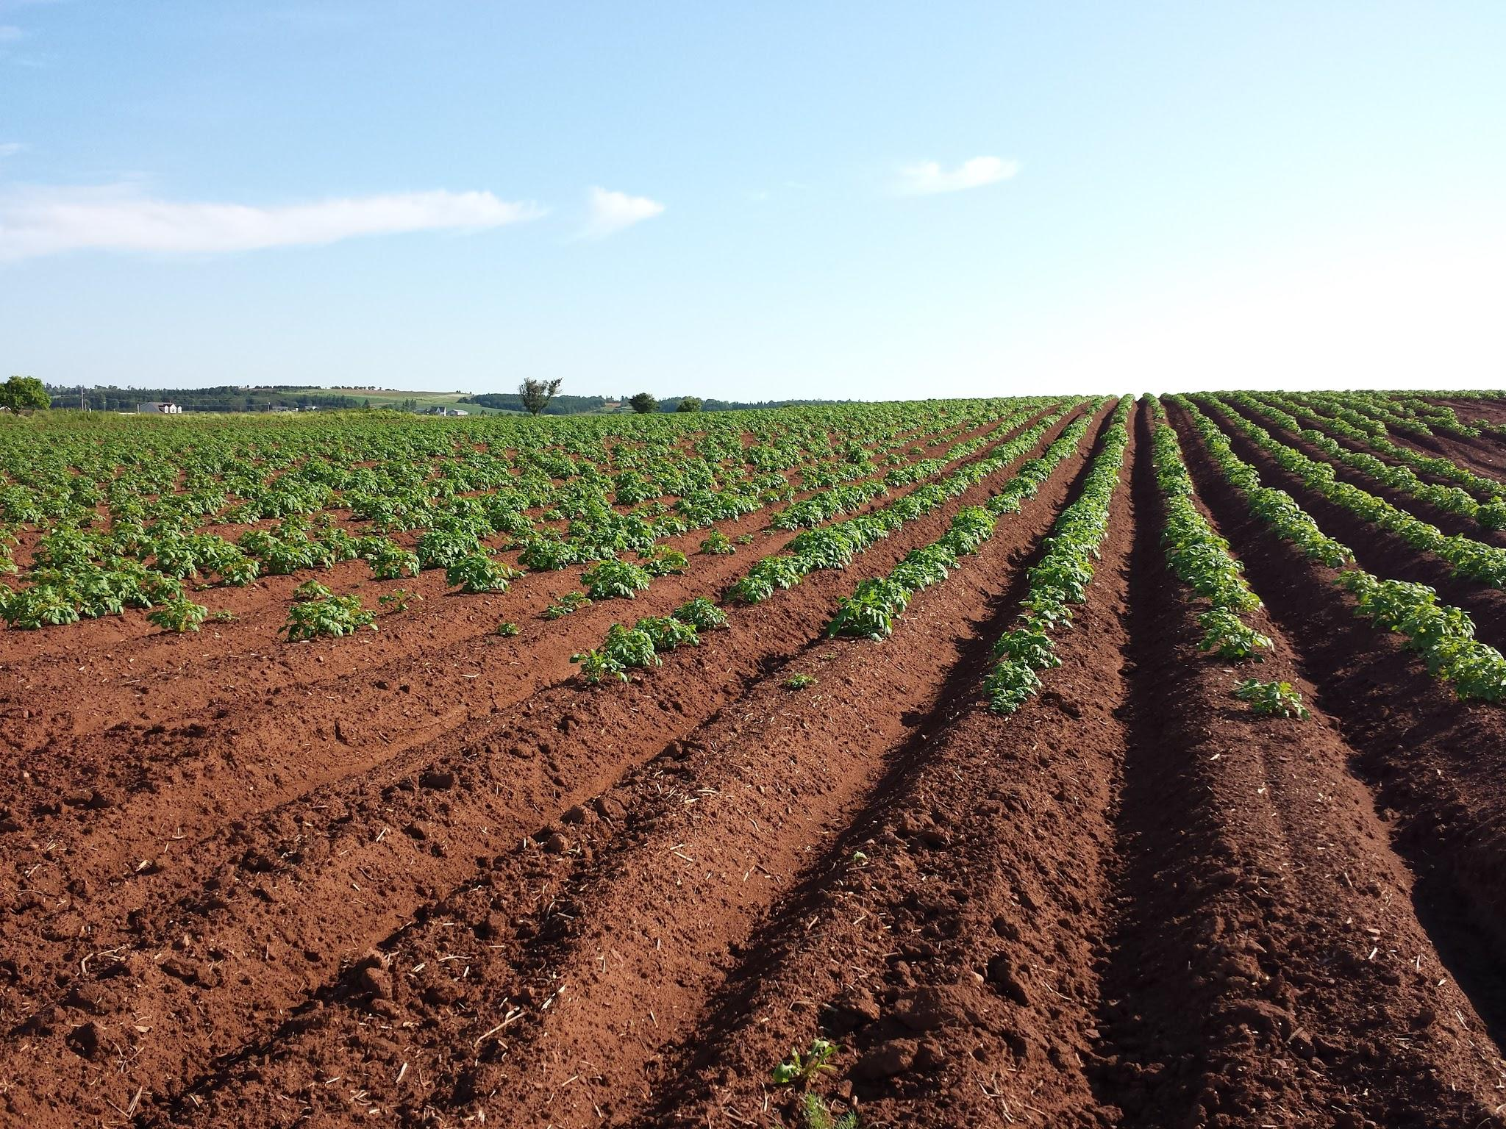
Horticulture Production
We provide 10 acres and seed input to grow clients crops
Weekly training and technical support
Assistance in getting product to market
Notes:
Each acre will be partitioned to allow individual space for the clients. Rental rates will be prorated based on the amount of time spent in the incubator, type of crop being grown, seasonality, and clients ability to pay. Typically the rental rates per acre/yr is between 75-180$. As the products are grown assistance will be given through our ‘know-how’ network to provide locations for clients to sell their products by either wholesale connections or at smaller markets

Slide 15
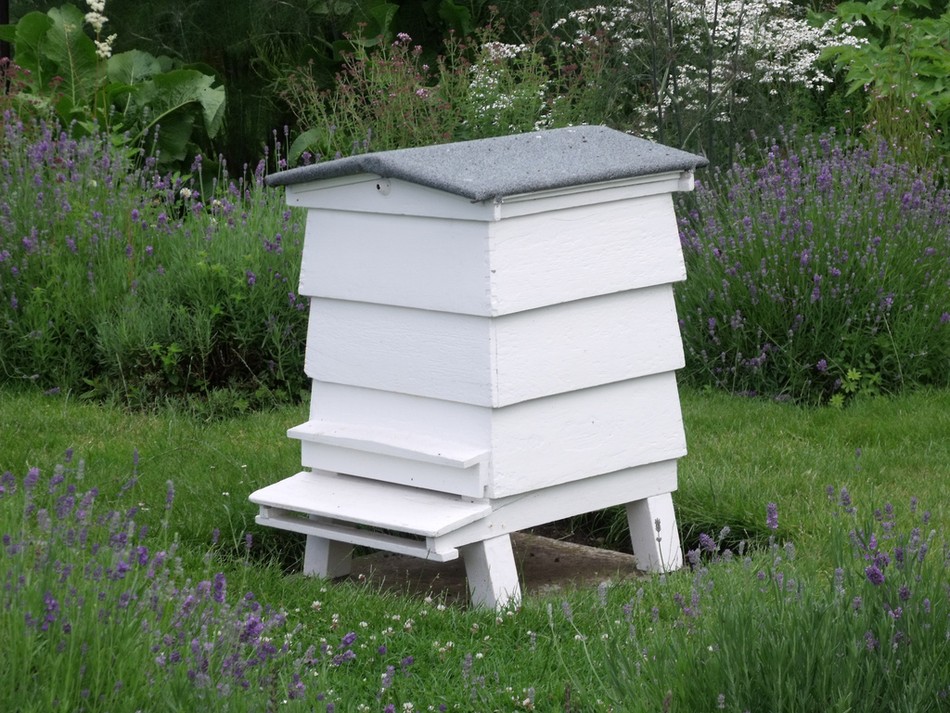
Pollination Services
On-site
Personalized Workshop (As needed) on maintenance and upkeep of hives
Honey production (selling a small excess)
Notes:
The pollinators main objective is to provide a teaching component for each of the clients in the incubator. As a model for potential business; information could be given on how a pollination operation could be managed with techniques learned on farm. Additionally they will provide pollination for all of the horticultural operations on farm. ~10 hives

Slide 16
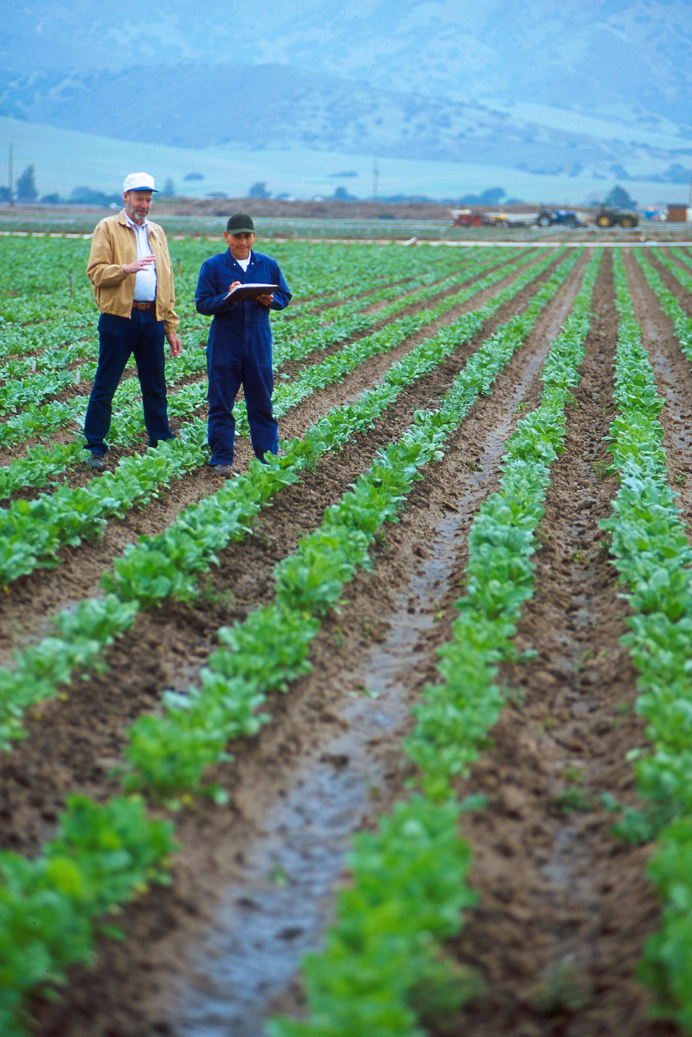
Candidate
Seeking a long-term career in horticulture and beef production (seeking profitability)
Basic Farming Education
Graduated through another beginning farmer training program (Future Harvest CASA)
Taken Penn State Home Study course
Looking for specific skills (Backgrounding, Horticulture, Pollinators, Business planning)
Must pass staff review and entrance interview

Slide 17
Programs
Application process
Create their plan
Each admitted person must participate in business counseling at least 1 sector on the farm (Backgrounding, Horticulture, Pollinators)
Experiential learning
Backgrounding
Students come to farm for orientation and then participate in a land link with a network farmer
Horticulture
Students come to work in the raised beds
Orientation for working with pollinators (assistance as needed afterwards)
Rent space in the greenhouse and use of pollinators

Slide 18
Program
Upon entrance to the program, rolling admission up to 10 candidates at a time, the candidate will have a meeting with the Farm director of operations
During the meeting the submitted application will be gone over with the new client to determine the best course of training for the applicant
There will mandatory business development class for each client along with assigned work based on areas of interest
The new client will have time during the first month to work each different section of the farm and begin training in areas of interest.

Slide 19
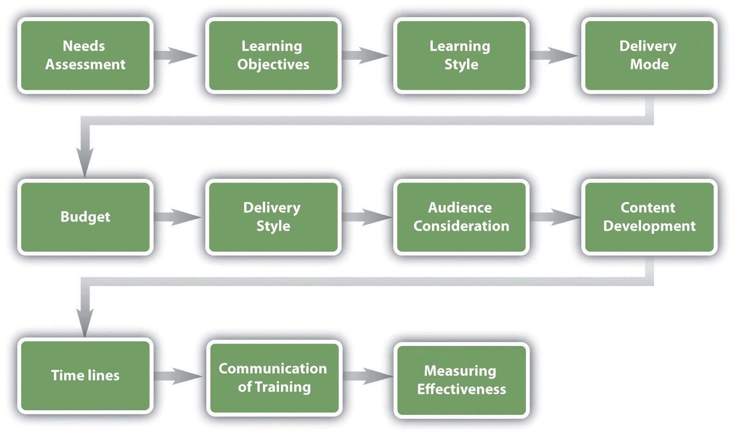
Program (cont.)
At the end of the first month a rough business plan for the client’s area of expertise will be produced
From there, an intensified and specialized plan for each client will be developed and consistently evaluated biweekly to ensure client success
Notes:
Because of the nature of the incubator, making curriculum spanning to cover each client verbatim would be extremely difficult. So because of this, the training/education will be dynamic, with goals set and reached within reasonable timeframes following the model on the right.

Slide 20
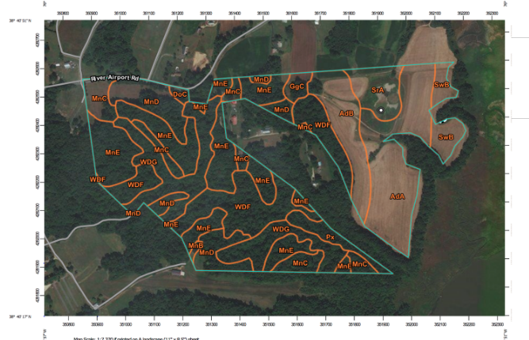
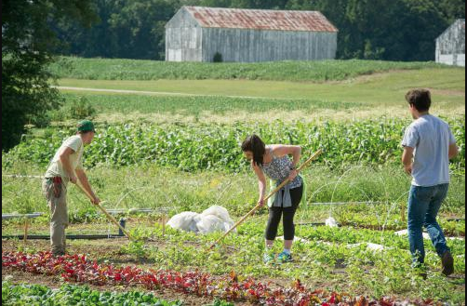
Facilities
Notes:
The incubator will operate on 2 facilities, Terp farm and Yates Claggett’s property. Terp Farm will house the greenhouse operations. Mr.Claggett’s property, which has roughly 45 usable acres, will house the backgrounding operation and 10 acres of raised beds.
Yates property was used as a placeholder for this project and the operations that have been allocated to this space may be moved to another location as space becomes available.

Slide 21
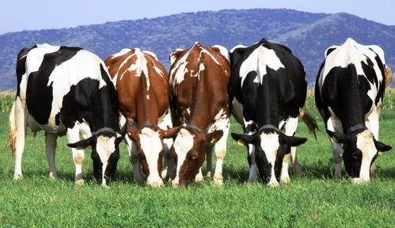
Financial Requirements
Capital Requirements: $671,141.74
Enterprises:
-Beef Backgrounding
-Green House production
-Raised Beds
- Beef Sales
- Pollinator Services
Notes:
Although our proposed system is heavily reliant on grant funding to be operational, our team thought it was imperative for long-term success to be as self-sustaining as possible. To accomplish this, we have chosen the following enterprises to generate income to support the incubator:
- Beef backgrounding
- Greenhouse/ Hydroponic flower, fruit and vegetable production
- Honey production & Pollinator Service.
- Meat Sales (whole, half, & quarter)
We have chosen the following enterprises in response to research on new and beginning farmers we conducted earlier this year. Our findings showed that a large percentage of farmers were going into livestock, specifically beef, as well as grain and vegetables. These enterprises will also serve as a platform to educate clients on best practice by industry, environmental sustainability, and animal husbandry for the industries they are getting into.
The construction and outfitting of these facilities will require $671,141.74.
Beef Backgrounding
Location: On site (35 acres)
Capacity: 30 head with supplemental feeding
The beef backgrounding operation will occur on site during the summer. All cows will be purchased at roughly 500 pounds and will be grass fed with some supplemental feeding to 1000 pounds. Half of the cows will be sold to a feedlot, while the other is retained to support our beef sales enterprise.
Southern Maryland currently is lacking any significant backgrounding operations. Creating this facility would help the numerous cow and calf operations that are currently operating in southern Maryland as it gives these farmers an outlet to sell cattle so they do not have hold on to animals for longer than is profitable.
Raised Beds:
Location: On site (10 Acres)
Capacity: 6-10 clients
We have allotted 10 acres on site for raised bed production. The space will be broken down in to 10 1-acre sections that can be rented out at $400 per acre a year. The incubator will not be constructing the raised beds, but will provided the clients with the materials to create their own. (New York Incubator is doing the same). In the first year we will retain two acres of raised beds for expansion of incubator clients. This space will be used to grow a variety of plants for sale in year 1 but will be rented out in the following years.
Hydroponic Greenhouse
Location: Terp Farm
Capacity: 8448 sqft.
The hydroponic greenhouse is 8448 square foot facility will be located at Terp Farm for the production of flower, fruits and vegetables. The facility will be broken down into three 2816 square foot bays of which two bays will be operated by the incubator, and one bay will be rented out for client use.
Honey Production and Pollinator services
Location: On site
Capacity: 10 Hives
Our incubator will offer clients using raised beds pollination services that will be rented out on a per hive basis. Pollination is an essential part in fruit and vegetable production and current service providers only work with larger farms.
As a bi-product of pollination services, we will be collecting and processing the honey produced by the hives to be sold direct to consumer (Insert Market Channel Here).
Beef Sales
Sales direct to consumers for whole, half, and quarter cuts.
Meat Sales and Equipment
Average Hanging Weight for Carcassà Whole, Half, and Quarter:
· Whole, 760 pounds for the average weight. (It comes from a range between 600-760lbs)
· Half, 360 pounds for the average weight. (It comes from a range between 300-360lbs)
· Quarter, 180 pounds for the average weight. (It comes from a range between 150-180lbs)
Pricing per pound (range is $3.50-$4.00)
· Whole, $3.50
· Half, $3.75
· Quarter, $4.00
Processing fee (about $0.65/pound)
· Whole, $494
· Half, $234
· Quarter, $117
Marketing
· Promotional Brochures - 1,000 brochures for $100
· A-signs for Farmers Market - $34.00 each x 2 signs = $68.00
· Car Magnets for our Truck - $35.00 each x 2 magnets = $70.00
· Banner for our Farmers Market Stand (2.5’ x 10’) - $40.00
· Stand-up Background sign for Farmers Market - $60
· ¼ Page Newspaper Ad (through Prince George’s County Sentinel) - $330 àThere is a 20% discount for non-profit organizations.
v Social Media Marketing done through an agency - $5,000
Equipment
· Freezer Trailer - $425 ($85/day to rent. It will be used for about 5 days a year.)
Transportation
· Costs to transfer live animals to processor and carcasses back. - $480 ($3.00/mile and 160 miles roundtrip.)

Slide 22

Employment Requirements
Full Time
General Manager: $60000
Application Process
Program Promotion
Handles incubator without walls
One Vegetable Production Manager: $56000
Greenhouse production
Manage greenhouse
Produce & Flower Sales
Part Time
Beef Backgrounding: $20000
Day to Day operations
Training/Education
Beef Sales

Slide 23
Regulatory Plan
Weights and Measures
$200 Fee annually for certification.
Applicators licenses
$150 annually for business license fee
$100 annually for certification fee
Nutrient Management Plan
Follow current management practices on both facilities.
Soil and Water Conservation Plan
Follow current management practices on both facilities.
USDA Grade A distribution permit
$300 annually business license fee

Slide 24
Cash Operating Budget
Revenue | Year 1 | Year 2 | Year 3
Beginning Cash | $300,000.00 | $319,967.87 | $192,836.13
Total Farm Revenue | $313,205.61 | $291,180.00 | $291,180.00
Grant Revenue | $176,000.00 | $20,000.00 | $20,000.00
Rental Revenue | $9,633.60 | $10,563.60 | $10,563.60
Total Revenue | $798,839.21 | $641,711.47 | $514,579.73
Expenses
Total Farm Expenses | $197,841.34 | $160,346.34 | $160,346.34
Salaries Expense | $136,000.00 | $136,000.00 | $136,000.00
License and Permit Expense | $750.00 | $750.00 | $750.00
Loan Payment (Principal) | $79,638.00 | $93,747.00 | $85,904.00
Loan Payment (Interest) | $34,722.00 | $28,112.00 | $20,952.00
Fringe | $29,920.00 | $29,920.00 | $29,920.00
Total Expenses | $478,871.34 | $448,875.34 | $433,872.34
NET INCOME | $319,967.87 | $192,836.13 | $80,707.39
Notes:
I have embedded the start up budget into the Cash operating budget
The incubator will require significant grant funding to become operational.
Some of the major assumptions that will change the budgets:
I have included corn into the beef backgrounding budget as a place holder to supplemental feed.
The enterprise budget for greenhouse production has a Tomatos as a place holder for flowers. The exact crop mix has not been determined. We are also using a dutch budget system, so certain only certain types of production can be done in the greenhouse.
Loan is based on a $470,000 principal to cover 70% of total capital expenditure that will be payed off in 5 years.

